Slide 1
DOM

Slide 2

TREE DATA STRUCTURE

Slide 3
DESCRIPTION
A DATA STRUCTURE THAT CONSISTS OF NODES IN A PARENT/CHILD RELATIONSHIP.
Tree are non-linear ( many different path).

Slide 4
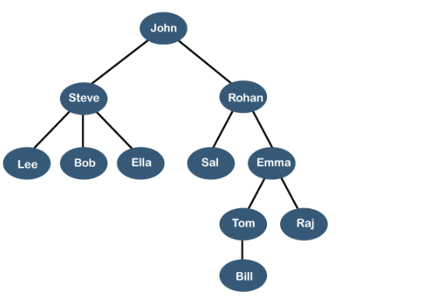
REAL TIME EXAMPLE LINKEDIN FRIENDS

Slide 5
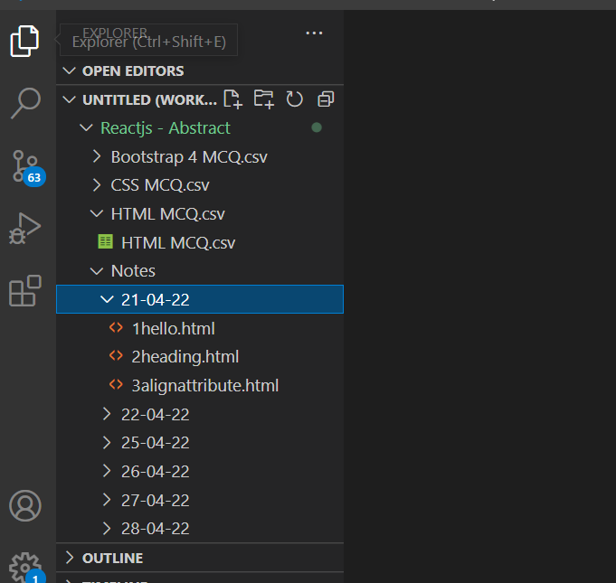
FILE SYSTEM

Slide 6
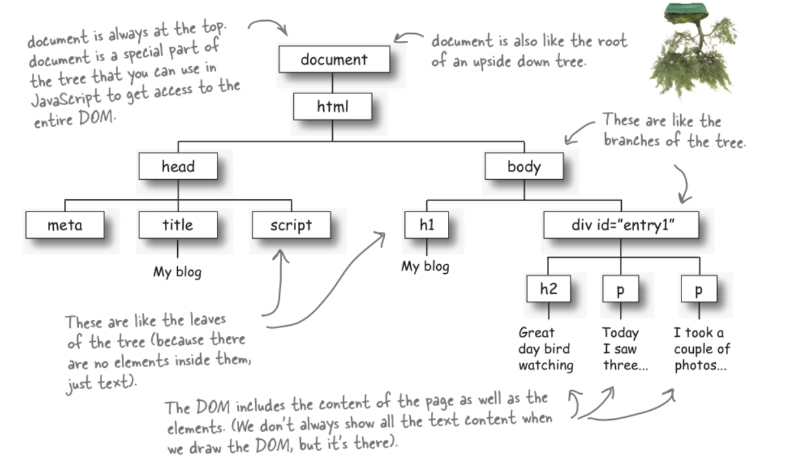
What is DOM ?
When a web page is loaded, the browser creates a Document Object Model of the page
The HTML DOM model is constructed as a tree of Objects:

Slide 7
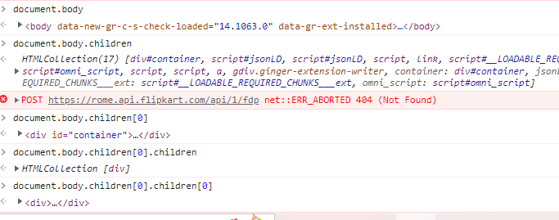
HTML DOM

Slide 8


What we can do using DOM?
Using DOM, JavaScript gets all the power it needs to create/update HTML:
JavaScript can change all the HTML elements in the page
JavaScript can change all the HTML attributes in the page
JavaScript can change all the CSS styles in the page
JavaScript can remove existing HTML elements and attributes
JavaScript can add new HTML elements and attributes
JavaScript can react to all existing HTML events in the page
www.credosystemz.com © Copyright 2021 | credosystemz | All Rights Reserved

Slide 9
DOM Methods
HTML DOM methods are actions you can perform (on HTML Elements)
HTML DOM properties are values (of HTML Elements) that you can set or change
<html>
<body>
<p id="demo"></p>
<script>
document.getElementById("demo").innerHTML = "Hello World!";
</script>
</body>
</html>
innerHTML is a property
getElementById is a method

Slide 10
DOM Methods
getElementById - To change/modify the content of an HTML element
<script>
document.getElementById("p1").innerHTML = "New text!";
</script>
Changing HTML Content
<script>
document.getElementById("myImage").src = "landscape.jpg";
</script>
Changing the Value of an Attribute
<script>
document.getElementById("myP").style.backgroundColor = "red";
</script>
Changing Style property
<script>
document.getElementById("myP").classList.add(“box”); </script>

Slide 11
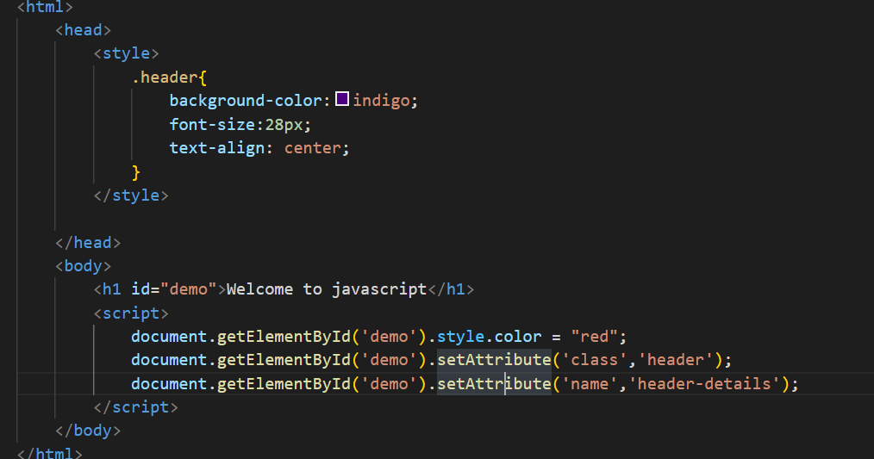
Style and class

Slide 12
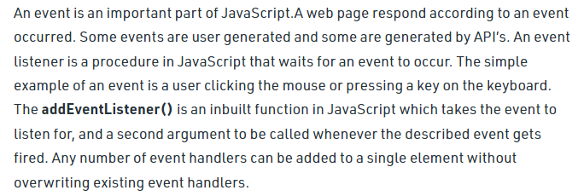
Event

Slide 13
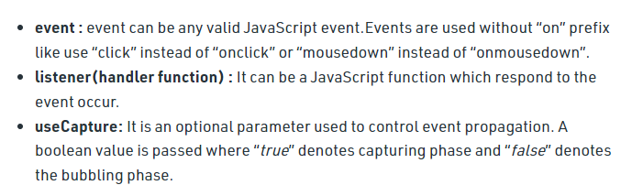
Event

Slide 14
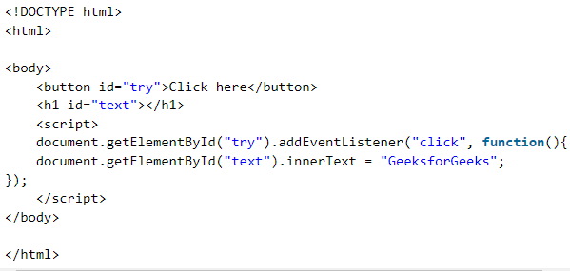
Event

Slide 15
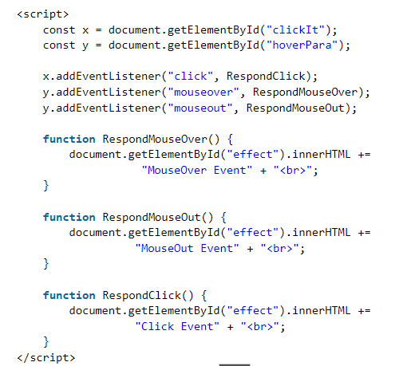
Event

Slide 16
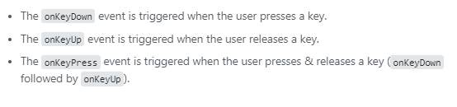
Event

Slide 17
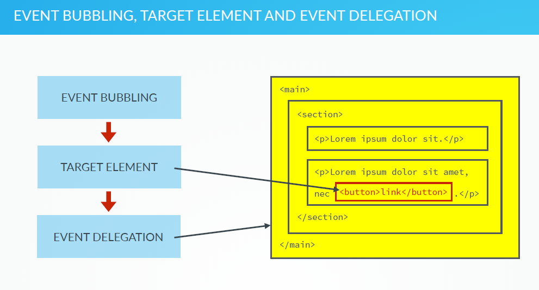

Slide 18
